Slide 1

"Exploring the Relationship Between Happiness and Suicide Rates: A Data Science Approach"
Zeynep Altın - 34416

Slide 2
My Datasets – Before Preprocessing
I got both of my datasets from kaggle.
Suicide Rates Overview 1985 to 2016 , which inlcudes: country, year, sex, age group, count of suicides, population, suicide rate, country-year composite key, HDI for year, gdp_for_year, gdp_per_capita, generation (based on age grouping average).
World Happiness Report (I used only years 2015 and 2016), which includes:
For 2015: Country, Region, Happiness Rank, Happiness Score, Standard Error, Economy (GDP per Capita), Family, Health (Life Expectancy), Freedom, Trust (Government Corruption), Generosity, Dystopia Residual.
For 2016: Country, Region,Happiness Rank, Happiness Score, Lower Confidence Interval, Upper Confidence Interval, Economy (GDP per Capita), Family, Health (Life Expectancy), Freedom, Trust (Government Corruption), Generosity, Dystopia Residual.

Slide 3
My Dataset – After Preprocessing
Country
year
sex
age
suicides_no
population
suicides/100k pop
country-year
gdp_for_year ($)
gdp_per_capita ($)
generation
Region
Happiness Rank
Happiness Score
Standard Error
Economy (GDP per Capita)
Family
Health (Life Expectancy)
Freedom
Trust (Government Corruption)
Generosity
Dystopia Residual
Note: There will still be changes on the dataset to fit for the machine learning methods.

Slide 4
MY HYPOTHESIS
Null Hypothesis (H₀): There is no significant relationship between happiness scores and suicide rates after controlling for economic and demographic variables.
Alternative Hypothesis (H₁): There is a significant relationship between happiness scores and suicide rates after controlling for economic and demographic variables.

Slide 5
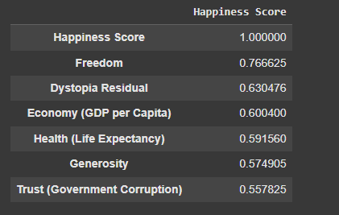
Correlation With Happiness Score
This is a correlation matrix shows how strongly each variable is related to the happiness score. All the listed factors are positively correlated with happiness score, with freedom and economy being among the strongest contributors. These values support the validity of using these variables in predictive models or deeper sociopolitical analysis.

Slide 6
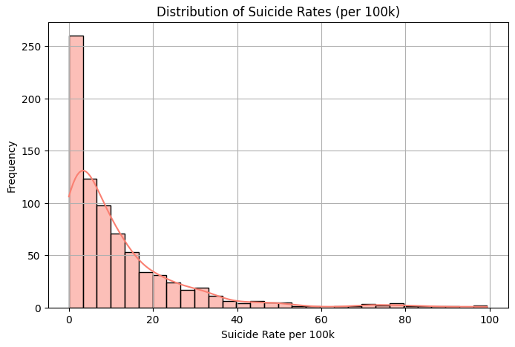
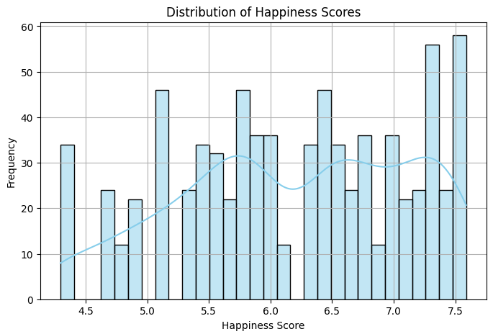
UNIVARIATE ANALYSIS
This histogram shows the distribution of suicide rates per 100,000 people.
The data is right-skewed, meaning most countries or demographic groups have relatively low suicide rates, with a few cases having much higher rates.
The peak near the lower end suggests that suicide is generally rare, but outliers exist.
This histogram shows the distribution of happiness scores, which appear roughly uniform with slight peaks around scores 6.0 and 7.5.
The relatively even spread suggests diverse happiness levels across countries without strong skewness.

Slide 7
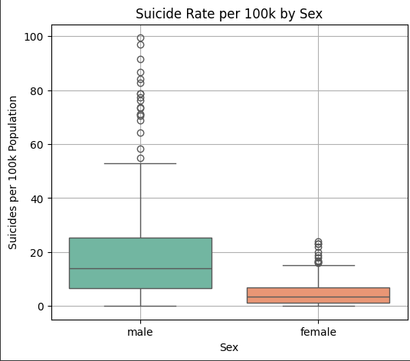
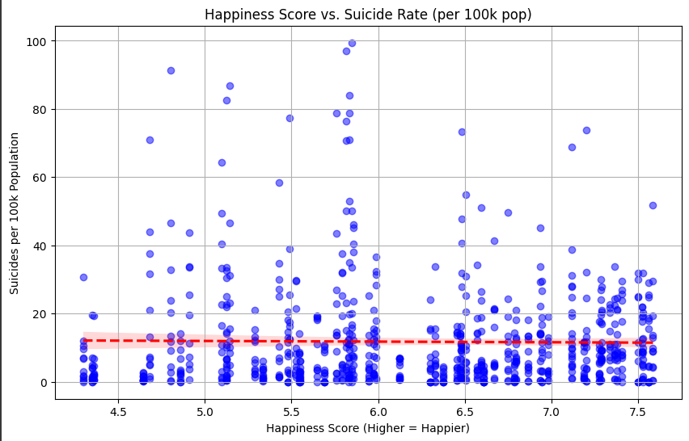
BIVARIATE ANALYSIS
This scatter plot explores the relationship between happiness scores and suicide rates, with a red dashed line indicating the mean suicide rate.
There is a wide spread of data points with no strong linear pattern, but visually, higher suicide rates appear more frequently at mid to low happiness scores.
This box plot shows that males have significantly higher and more variable suicide rates compared to females.
Male suicide rates have a wider interquartile range and more outliers, supporting known demographic patterns.

Slide 8
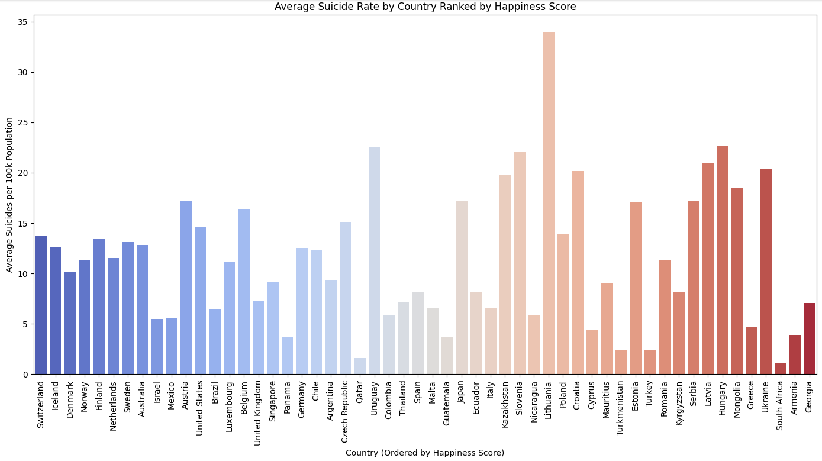
BIVARIATE ANALYSIS
This bar chart presents average suicide rates per 100k population, sorted by increasing happiness scores.
There is a loose trend where countries with higher happiness scores tend to have lower suicide rates, although there are clear exceptions (like some high happiness countries with mid-range suicide rates).

Slide 9
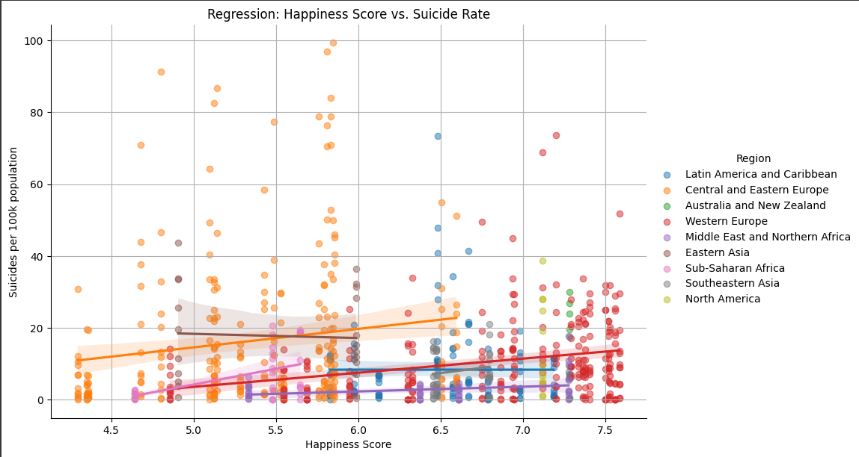
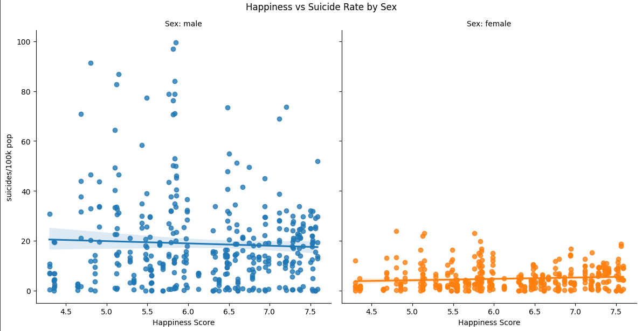
MULTIVARIATE ANALYSIS
This plot shows regression lines for different world regions. Notably, Central and Eastern Europe displays a positive relationship between happiness and suicide rates, unlike most other regions, which show flat or slightly negative trends.
These scatter plots compares the relationship by sex. Males show higher suicide rates across all happiness levels, with a slightly decreasing trend as happiness increases, whereas females show lower overall rates with minimal variation by happiness level.

Slide 10
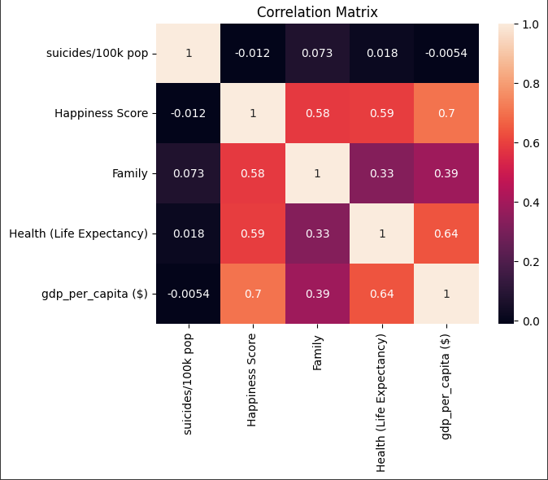
MULTIVARIATE ANALYSIS
This heatmap reveals weak negative correlation between suicide rates and happiness score (−0.012), indicating almost no linear relationship. Happiness score is positively correlated with gdp per capita, health, and family support, suggesting these factors contribute more strongly to happiness than to suicide rates.

Slide 11
ML MODELS
My purposes for using ML:
Prediction: To build models that can accurately predict suicide rates based on demographic, economic, and happiness-related features. This also shows how well suicide rates can be estimated using available indicators across countries and years.
Feature Impact and Insight: By analyzing feature coefficients (in linear regression) and feature importance scores (in random forest), I identify which factors most influence suicide rates. This helps test my hypothesis.

Slide 12
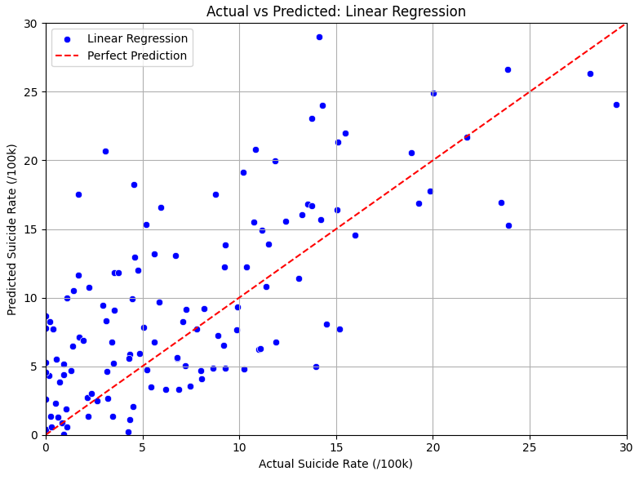
LINEAR REGRESSION
This model explains 60.8% of the variation in suicide rates based on the features.
This model reveals that happiness-related features still have a significant impact on suicide rates after controlling for sex, age, region, generation, population, and gdp.
Specifically, freedom has a coefficient of –1.61, indicating that greater freedom is associated with lower suicide rates; family has a coefficient of +2.43, and economy (gdp per capita) has +1.92, both unexpectedly linked to higher suicide rates. These non-zero coefficients show that happiness components contribute meaningful explanatory power to the model.
Linear Regression Evaluation:
R² Score : 0.6081
RMSE (Error) : 10.7041
MAE (Abs Error): 6.6224

Slide 13
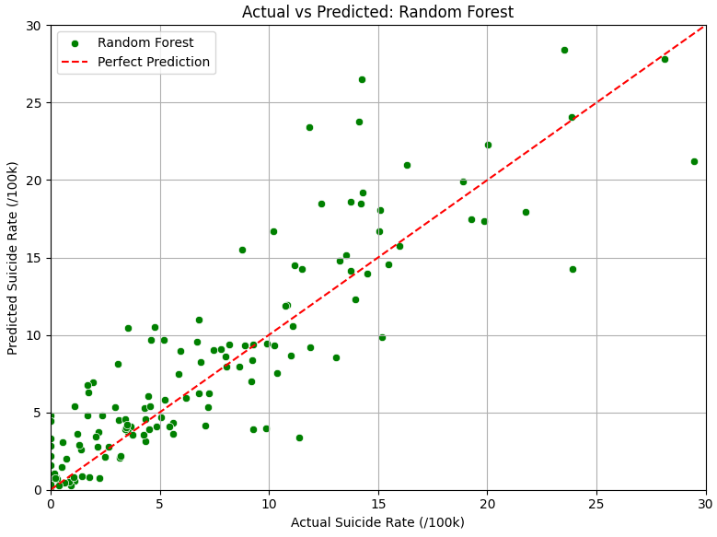
RANDOM FOREST
Model explains 84.2% of the variation in suicide rates Average error is about 6.8 suicides per 100k (much lower than linear regression).
 | On average, predictions are only 3.88 off (very accurate). In conclusion the random forest model fits my data significantly better than linear regression.
This model also shows that gender, age, and region are the most influential predictors of suicide rates, with sex_male (importance: 0.181) and male_75+ years (importance: 0.101) ranking highest.
Happiness-related features like generosity, economy, family, trust, and freedom each contribute around 0.04–0.05, confirming they still play meaningful roles in prediction.
Random Forest Evaluation:
R² Score : 0.8417
RMSE (Error) : 6.8031
MAE (Abs Error): 3.8818

Slide 14
Conclusion
To conlude I also used hypothesis testing (OLS regression model).
Freedom had a negative coefficient (–1.61) with a p-value of 0.071, indicating a borderline effect.
Family had a positive coefficient (+2.43) and was statistically significant (p < 0.001).
Economy showed a positive effect (+1.92) but was not statistically significant (p = 0.276).
These findings support the rejection of the null hypothesis for at least one happiness-related variable, meaning happiness factors do have a meaningful and statistically supported impact on suicide rates, even after accounting for other influences.

